Slide 1
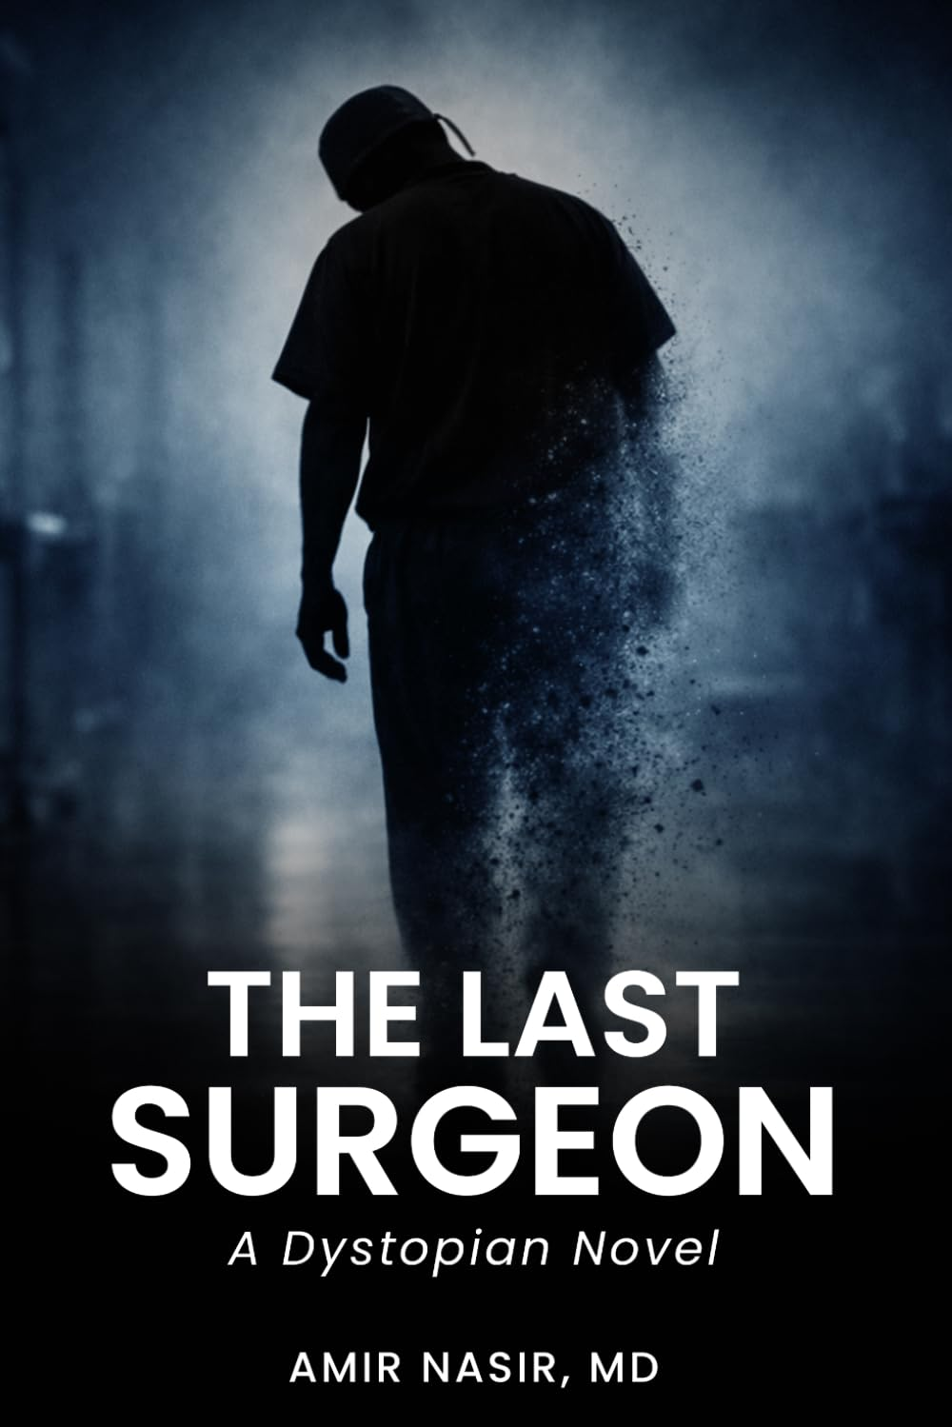
ONE-CLASS LESSON
The Last
Surgeon
When machines outperform even highly trained professionals, what happens to human expertise, identity, and purpose?
A 50-60 minute discussion using the free first chapter
THE LAST SURGEON | CHAPTER ONE
1
Notes:
Open with the question. Ask students to hold their answer until the end of class.
Source: Amir Nasir, The Last Surgeon, Chapter One.

Slide 2
BEFORE READING
Which profession will be hardest to automate?
01
Name one profession.
Then name the specific human ability that protects it.
Write two sentences. Do not discuss yet.
THE LAST SURGEON | CHAPTER ONE
2
Notes:
Give students two quiet minutes. Save their predictions so they can revisit them during the exit ticket.
Source: Amir Nasir, The Last Surgeon, Chapter One.

Slide 3
EVIDENCE SORT
What Chapter One actually shows
THE SYSTEM
DAVID AND THE INSTITUTION
What works?
What improves?
What becomes cheaper or safer?
What disappears?
Who made each decision?
What remains legal but impractical?
Keep technology performance separate from insurance, pricing, staffing, and policy.
THE LAST SURGEON | CHAPTER ONE
3
Notes:
Students work in pairs with the handout. Press them to classify evidence before evaluating it.
Source: Amir Nasir, The Last Surgeon, Chapter One.

Slide 4
CLOSE READING
Efficiency and absence occupy the same room
The waiting room
Which details make it orderly? Which make it empty?
The malpractice notice
Who defines the human surgeon as the riskier choice?
The former team photograph
What kind of loss can a metric record, and what kind can it miss?
The final line
Why end with an action that no one notices?
THE LAST SURGEON | CHAPTER ONE
4
Notes:
Invite students to read one sentence or detail aloud for each prompt. Ask how the details work together, not just what each detail means alone.
Source: Amir Nasir, The Last Surgeon, Chapter One.

Slide 5
WORK AND IDENTITY
What has David lost besides income?
Expertise
Purpose
Colleagues
Status
A future he expected
Choose two. Find one detail for each.
THE LAST SURGEON | CHAPTER ONE
5
Notes:
Treat the words as hypotheses. Students may reject one if the chapter does not support it.
Source: Amir Nasir, The Last Surgeon, Chapter One.

Slide 6
RESPONSIBILITY
Who or what causes the human cost?
The machines
The insurer
The hospital
The market
David himself
You may assign responsibility to more than one. Explain the connection.
THE LAST SURGEON | CHAPTER ONE
6
Notes:
Ask students to connect actors. For example, a machine may produce the data while an insurer turns the data into a coverage decision.
Source: Amir Nasir, The Last Surgeon, Chapter One.

Slide 7
FOUR-CORNER DISCUSSION
What does Chapter One depict?
PROGRESS
LOSS
BOTH
INSUFFICIENT EVIDENCE
The benefits outweigh the loss
The human cost outweighs the benefits
The contradiction is the point
The chapter does not show enough
Choose. Hear one challenge. Revise or defend.
THE LAST SURGEON | CHAPTER ONE
7
Notes:
Give students permission to move after hearing another argument. Ask movers to identify the evidence that changed their position.
Source: Amir Nasir, The Last Surgeon, Chapter One.

Slide 8
DISCUSSION
Four questions worth staying with
01
Has anyone explicitly forbidden David from working? Why does that distinction matter?
02
Who benefits from the system described in the chapter? Who bears its costs?
03
If autonomous surgery is safer and cheaper, what reason remains for choosing a person?
04
What evidence would make you reconsider your current position?
THE LAST SURGEON | CHAPTER ONE
8
Notes:
Choose two questions if time is short. Require students to refer to Chapter One rather than general AI examples.
Source: Amir Nasir, The Last Surgeon, Chapter One.

Slide 9
EXIT TICKET
The most important human cost
In 75-100 words, identify the most important human cost in Chapter One and explain who or what causes it.
Use one specific detail from the chapter.
Then revisit your opening profession prediction. Did it survive?
THE LAST SURGEON | CHAPTER ONE
9
Notes:
Collect the exit ticket or use it as the opening paragraph for a longer response.
Source: Amir Nasir, The Last Surgeon, Chapter One.

